Slide 1

EAI Capstone Project Intrusion Detection System Using Artificial Intelligence
Craig Perkins
January 2023
EAI6980

Slide 2

CAPSTONE OVERVIEW
Evidence suggests the US loses hundreds of billions to cybercrime annually – according to NIST
The high-profile hack of Equifax has cost the company $3.8B and potentially affected 143 million people
Attackers keep seeking novel attack vectors to exploit vulnerable software
Companies need tools to mitigate the risk of cyberattack

Slide 3

Dataset
UNSW-NB15 Dataset from University of South Wales
Originates from 100GB of raw tcpdump data
Contains 49 features
Train data set has 175,341 records and test dataset has 82,332 records
Has nine types of attacks, namely, Fuzzers, Analysis, Backdoors, DoS, Exploits, Generic, Reconnaissance, Shellcode and Worms

Slide 4
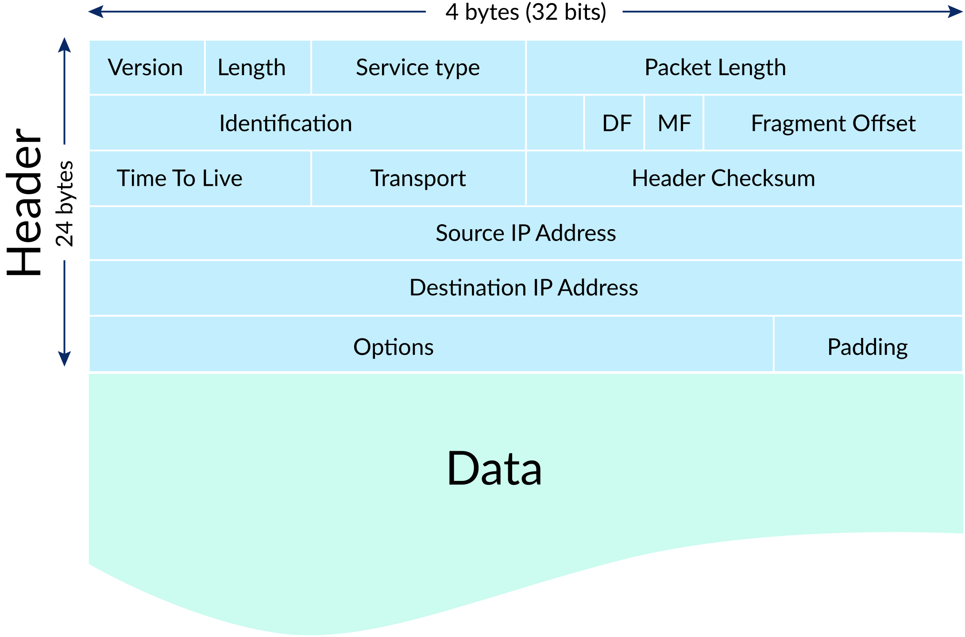
tcpdump
A powerful command-line packet analyzer
In networking, a packet is a small segment of a larger message
You can think of IP packets like postal letters: the header is the envelope with all the routing information that's needed by the post office, and the payload is the letter that's read only by the recipient.
TCP/IP - Transmission Control Protocol/Internet Protocol

Slide 5
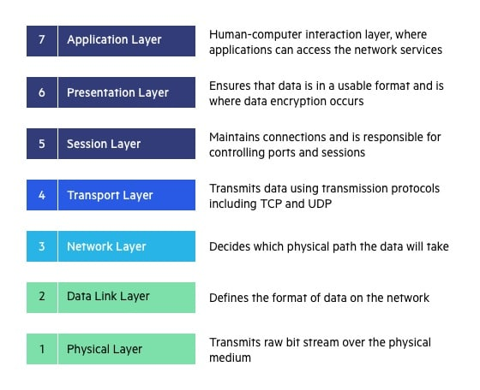
OSI Model
OSI is short for Open Systems Interconnection
TCP and UDP fall into the Transport Layer
Each layer above depends on services provided by the layers below
Divided into upper and lower layers. Upper layer includes Application, Presentation and Session Layers. Lower level includes Transport, Network, Data Link and Physical Layers

Slide 6
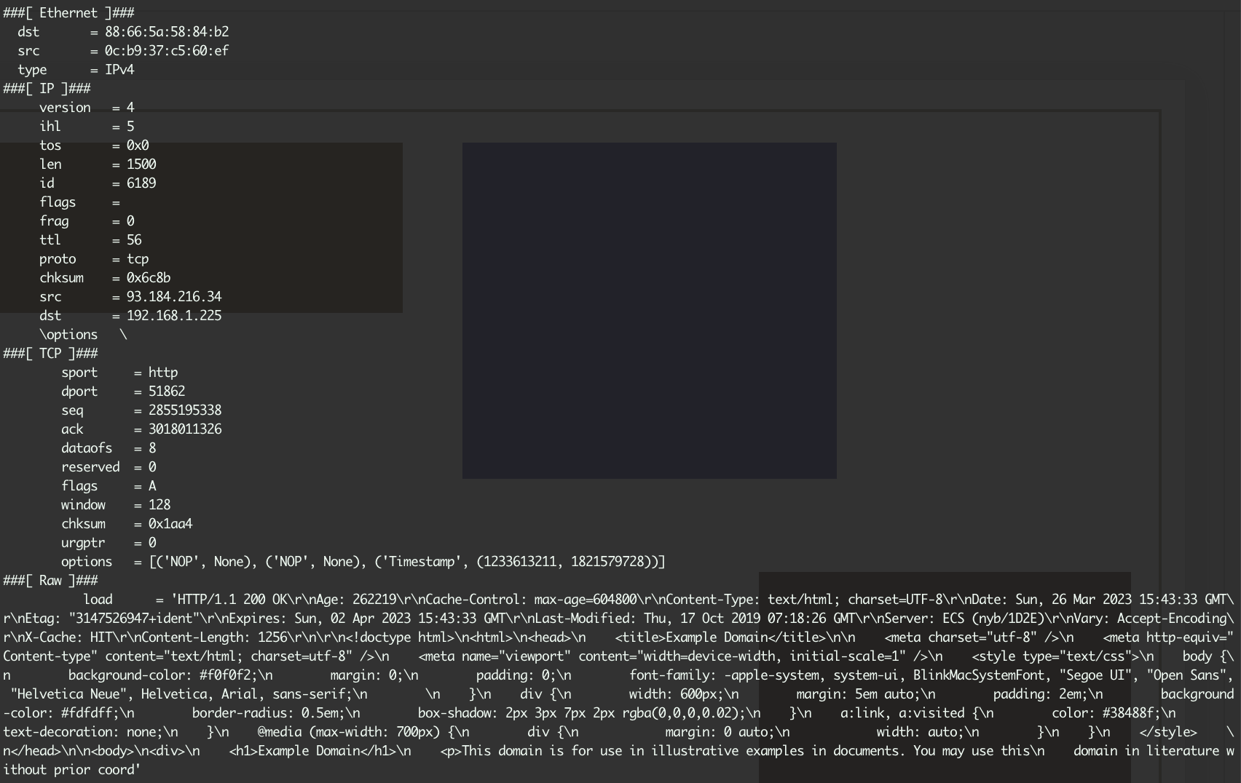
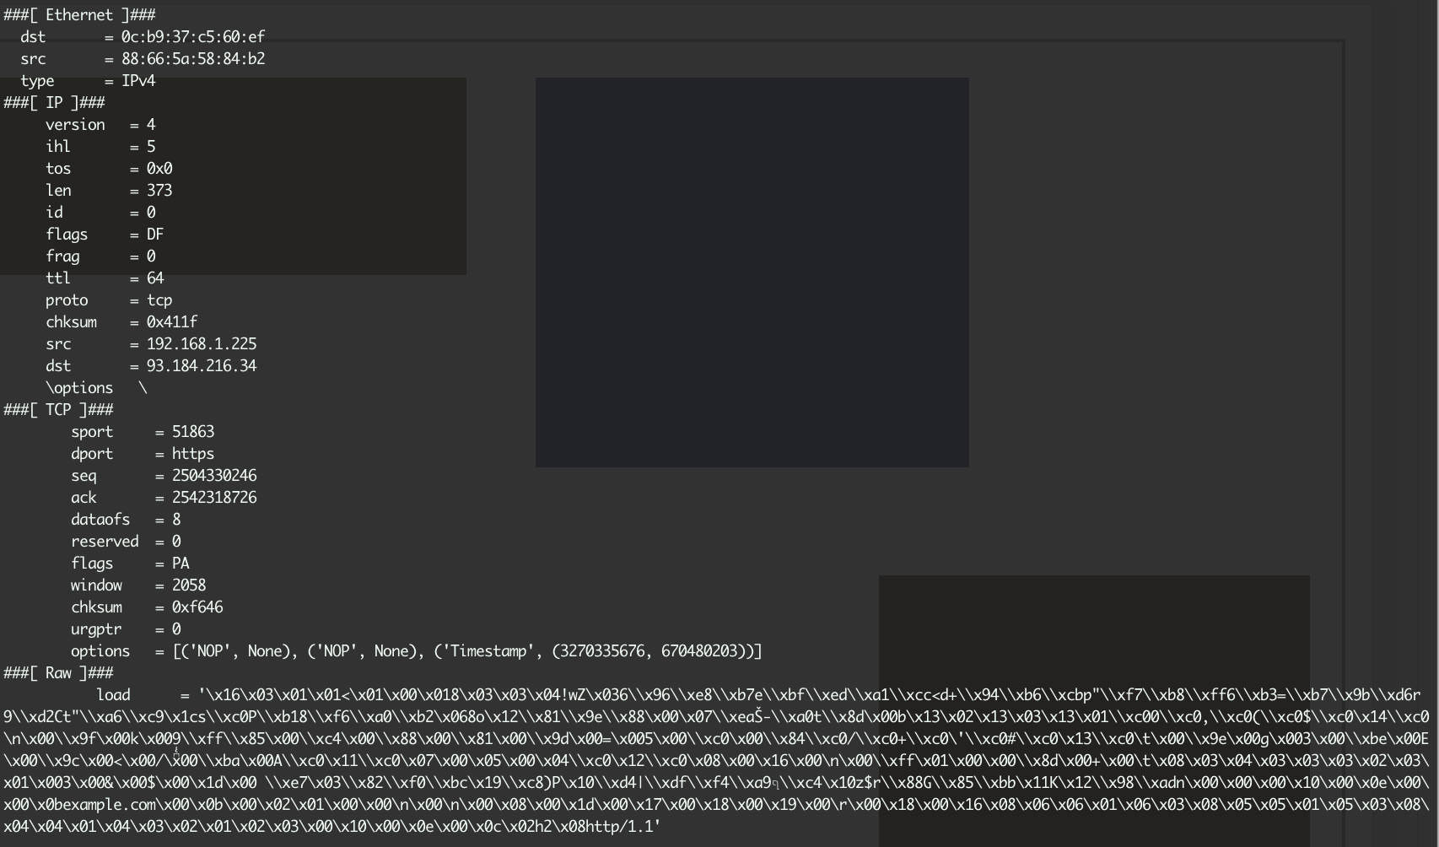
Example – Demo with Packet Sniffer and cURL
HTTP – No Encryption
HTTPS – Packet data is encrypted with Public/Private Key

Slide 7
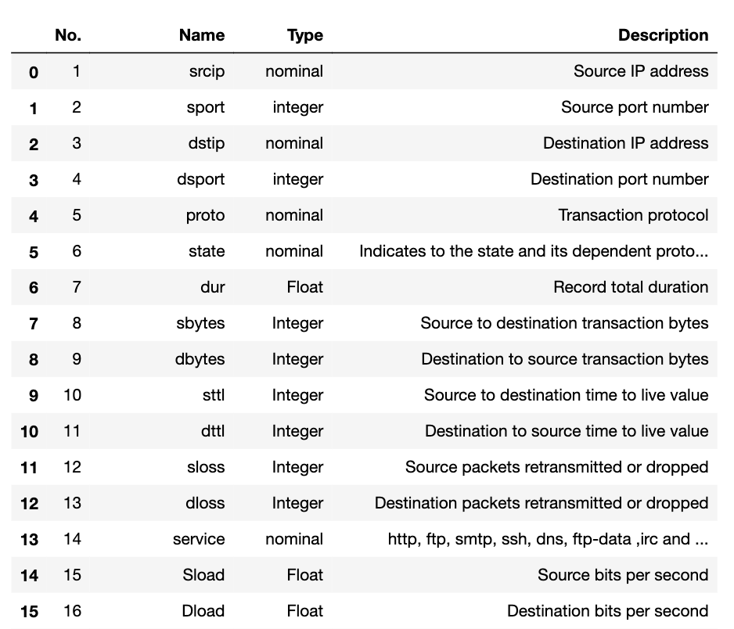
Features in the Dataset

Slide 8
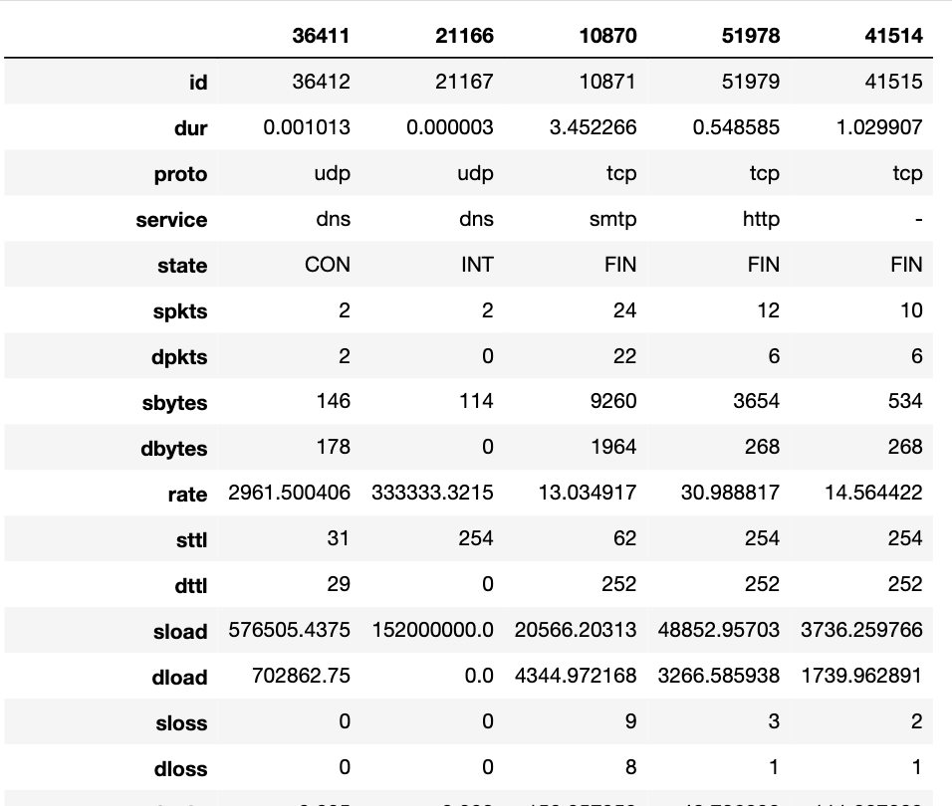
Sample Records

Slide 9
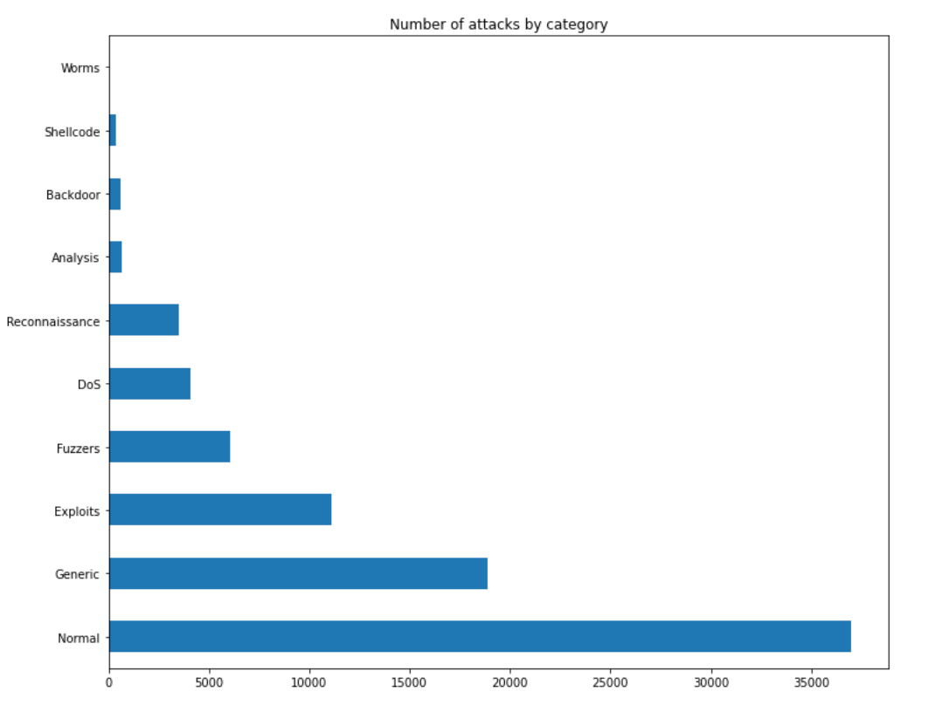
Attacks by Category

Slide 10
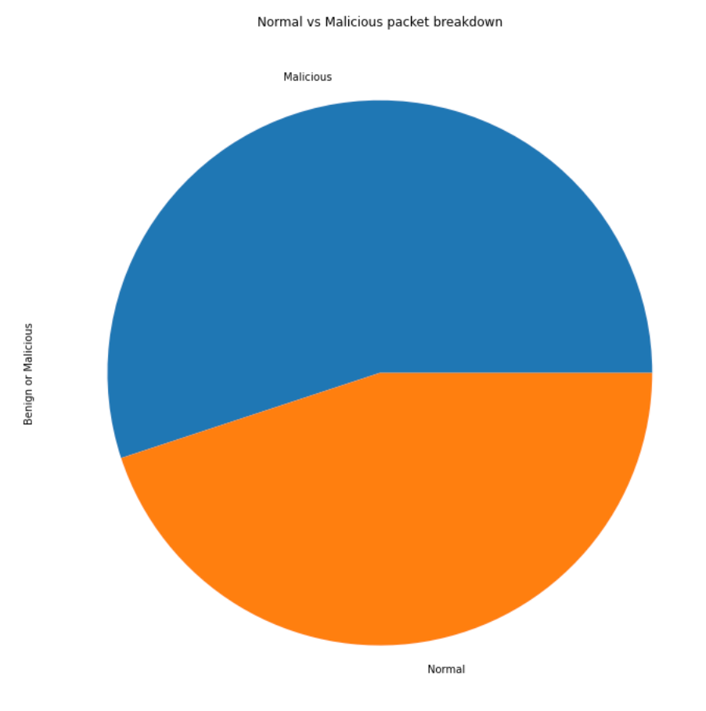
Balance of Classes in the Dataset

Slide 11
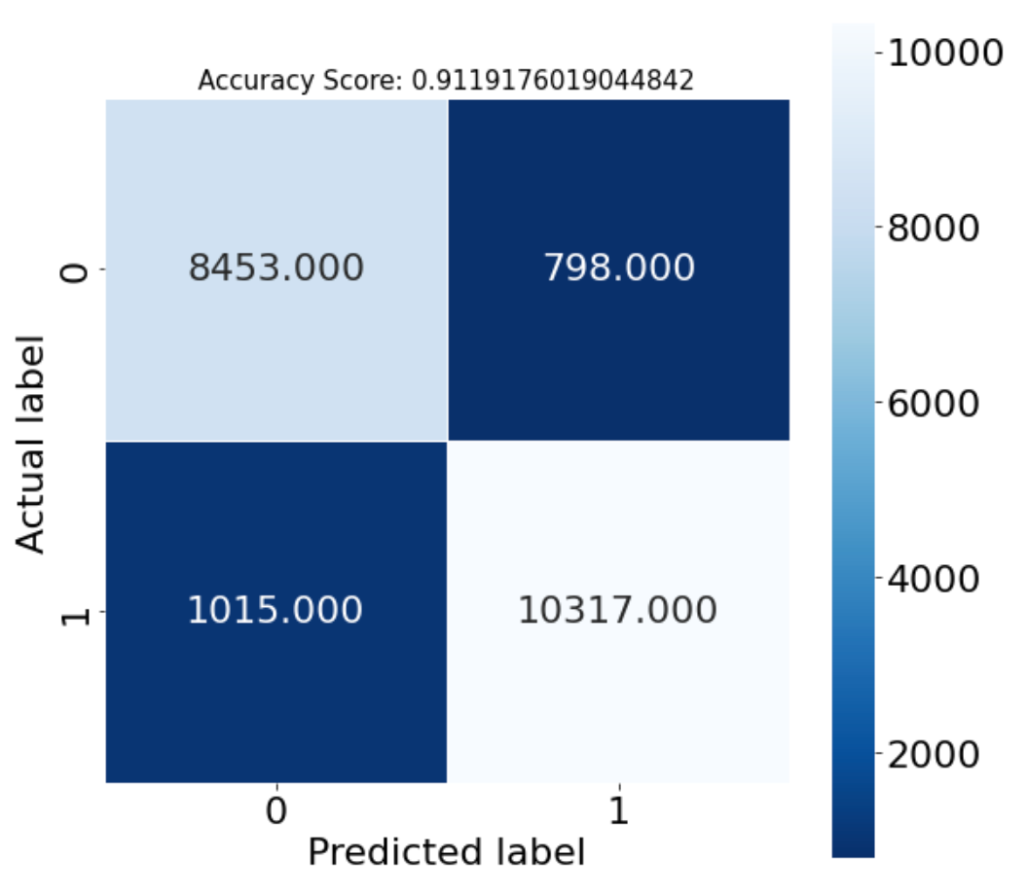
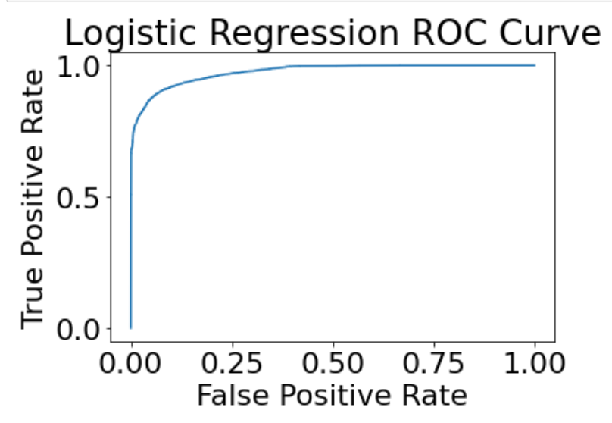
Model 1 – sk-learn - Logistic Classifier
First model performed was a Logistic Regression
The Logistic classifier had 85.3% accuracy
The classifier was quick to train

Slide 12
Model 2 – Decision Tree | Model 3 – Random Forest | Model 4 – XGBoost Classifier | Model 5 – Ada Boost Classifier
{ 'ccp_alpha': 0.0, 'class_weight': None, 'criterion': 'gini', 'max_depth': None, 'max_features': None, 'max_leaf_nodes': None, 'min_impurity_decrease': 0.0, 'min_samples_leaf': 1, 'min_samples_split': 2, 'min_weight_fraction_leaf': 0.0, 'random_state': None, 'splitter': 'best' } | { 'bootstrap': True, 'ccp_alpha': 0.0, 'class_weight': None, 'criterion': 'gini', 'max_depth': None, 'max_features': 'sqrt', 'max_leaf_nodes': None, 'max_samples': None, 'min_impurity_decrease': 0.0, 'min_samples_leaf': 1, 'min_samples_split': 2, 'min_weight_fraction_leaf': 0.0, 'n_estimators': 100, 'n_jobs': None, 'oob_score': False, 'random_state': None, 'verbose': 0, 'warm_start': False } | { 'objective': 'binary:logistic', 'use_label_encoder': None, 'base_score': None, 'booster': None, 'callbacks': None, 'colsample_bylevel': None, 'colsample_bynode': None, 'colsample_bytree': None, 'early_stopping_rounds': None, 'enable_categorical': False, 'eval_metric': None, 'feature_types': None, 'gamma': None, 'gpu_id': None, 'grow_policy': None, 'importance_type': None, 'interaction_constraints': None, 'learning_rate': None, 'max_bin': None, 'max_cat_threshold': None, 'max_cat_to_onehot': None, 'max_delta_step': None, 'max_depth': None, 'max_leaves': None, 'min_child_weight': None, 'missing': nan, 'monotone_constraints': None, 'n_estimators': 100, 'n_jobs': None, 'num_parallel_tree': None, 'predictor': None, 'random_state': 42, 'reg_alpha': None, 'reg_lambda': None, 'sampling_method': None, 'scale_pos_weight': None, 'subsample': None, 'tree_method': None, 'validate_parameters': None, 'verbosity': None } | { 'algorithm': 'SAMME.R', 'base_estimator': 'deprecated', 'estimator': None, 'learning_rate': 1.0, 'n_estimators': 50, 'random_state': None }
Accuracy: 85.7% | Accuracy: 89.2% | Accuracy 88.6% | Accuracy: 87.8%

Slide 13
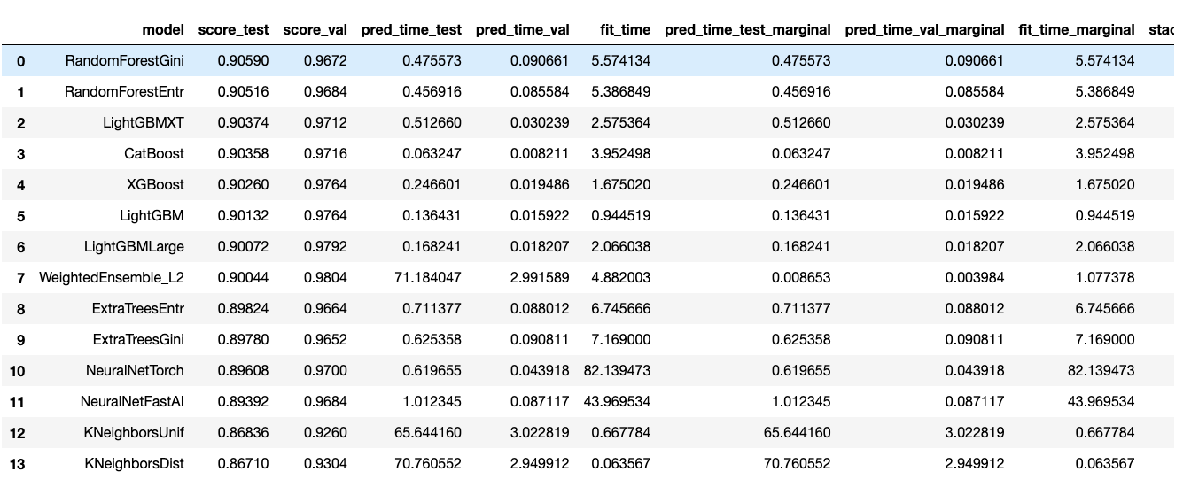
AutoGluon – Using AutoML for Model Selection
AutoML is useful for model selection and getting a baseline accuracy to improve upon
AutoML tools quickly perform hyperparameter tuning and create a leaderboard of models
Leadership is ranked by eval_metric – default is accuracy

Slide 14
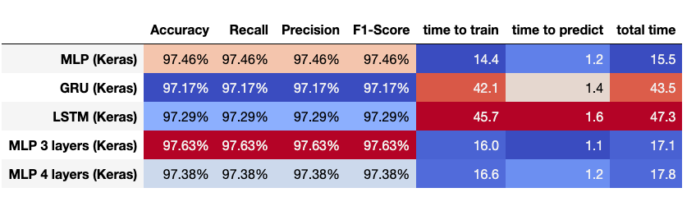
Neural Networks
Used Keras and Tensorflow
Built a Multi-Layer perceptron (MLP 2, 3 and 4 Layer), GRU and LSTM models
LSTM was the highest rank on validation set
Metrics below are for validation set – 75% train and 25% validate

Slide 15
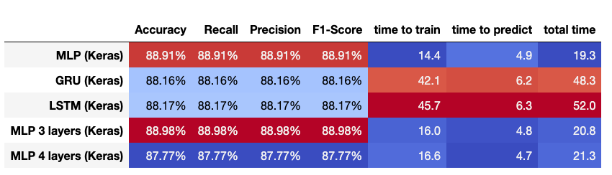
Model Evaluation
Time to train and time to predict are important factors
Both train-test split and dedicated test dataset with many samples used to evaluate models
MLP with 3 layers was the highest ranked

Slide 16
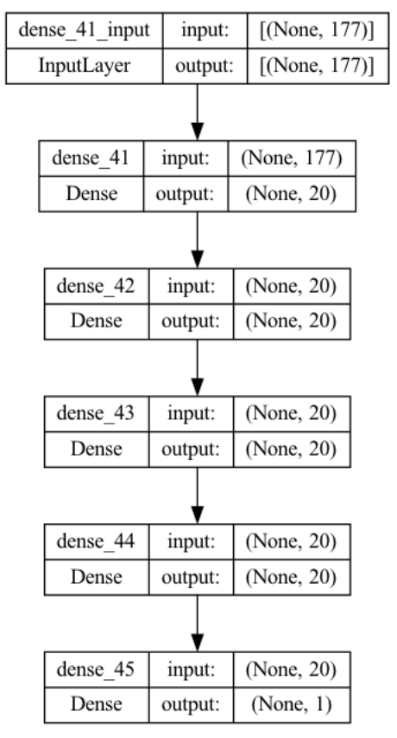
MLP 4-Layers Visualization

Slide 17
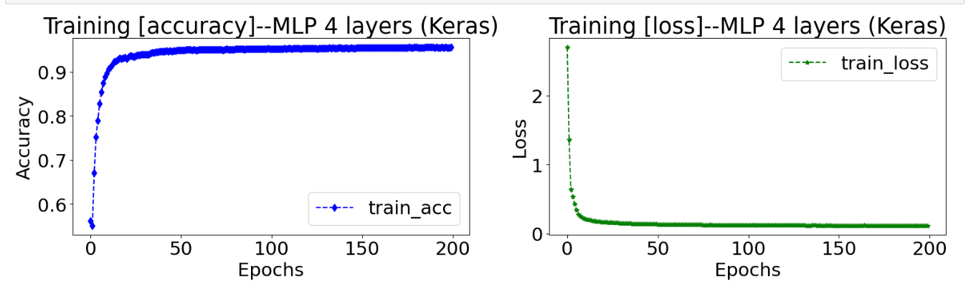
Model Training
With Keras, Multi-Layer Perceptrons took appropriate time to training, but scaled with the complexity of the network
LSTM and GRU models took more than double as long to train as feed forward networks
Epochs gave diminishing returns over time, the more epochs for training meant that less time could be used experimenting with other models

Slide 18
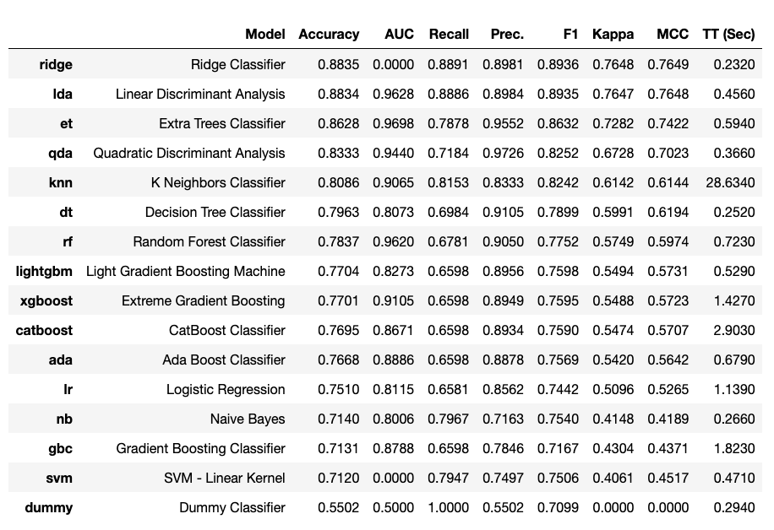
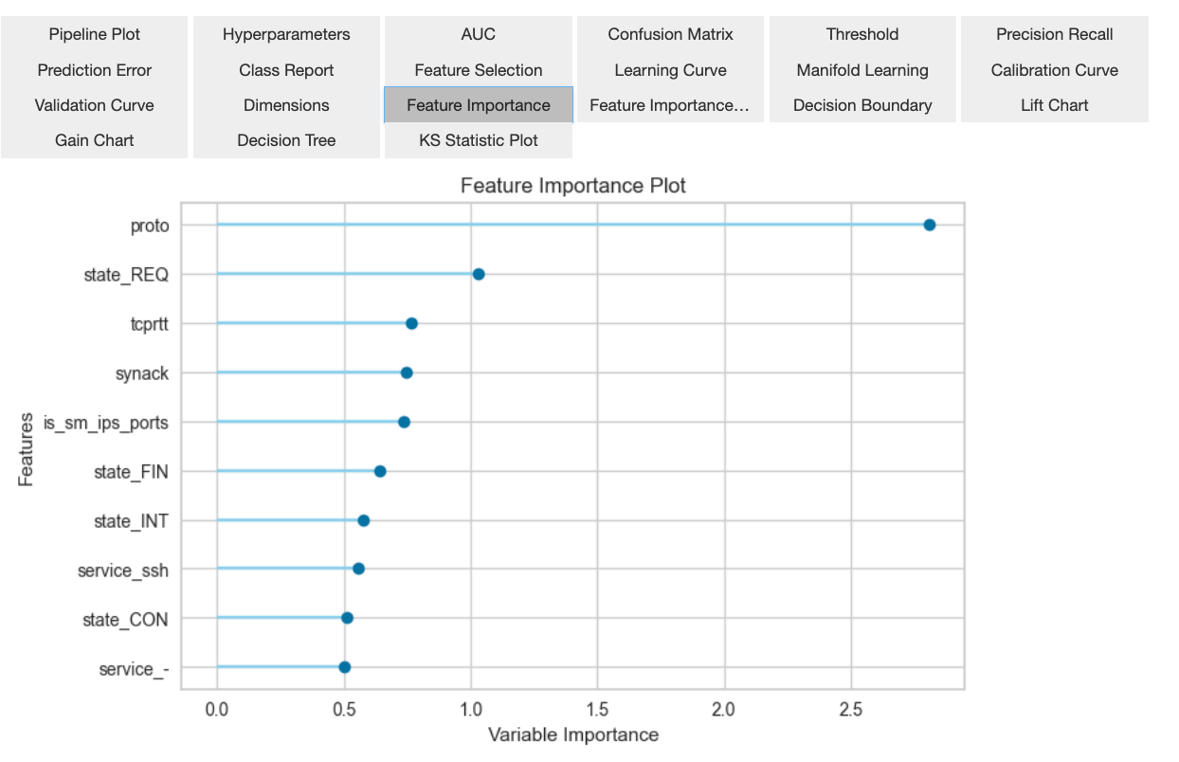
PyCaret Leaderboard
PyCaret is another open-source AutoML Library
PyCaret provides a nice interface for evaluating the best model

Slide 19
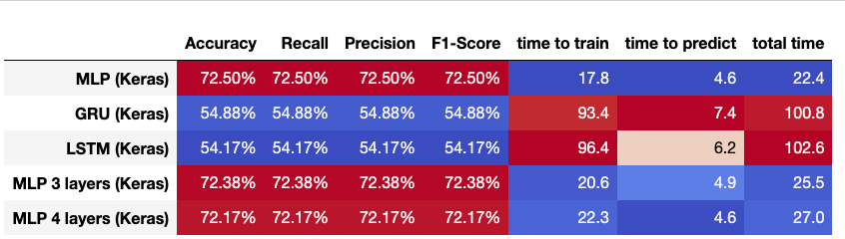
Multi-Class Classification
10 Classes to predict
Much lower in accuracy

Slide 20
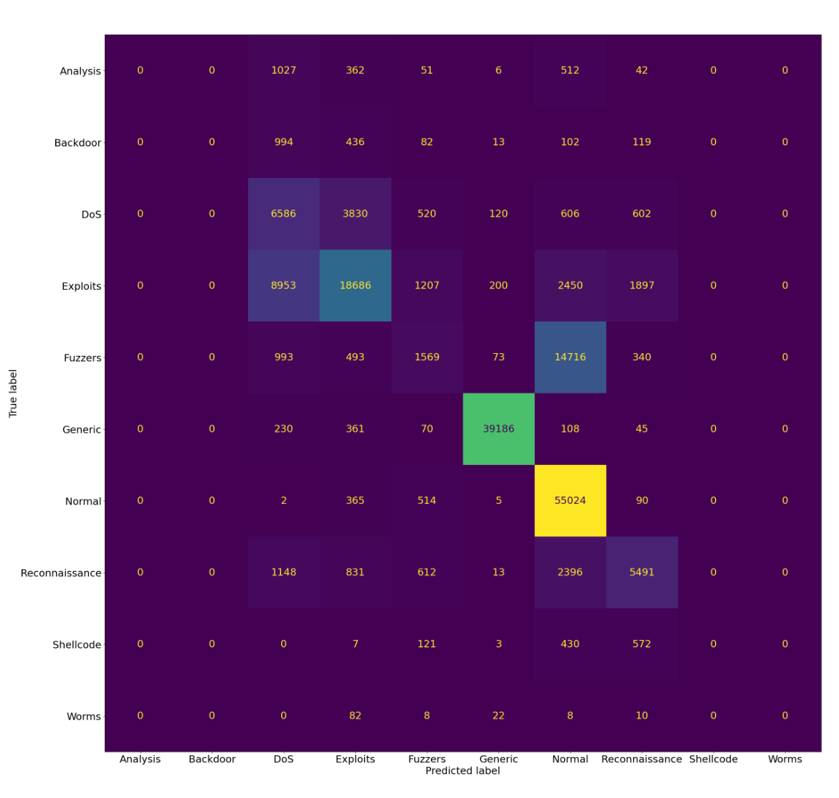
Multi-Class Confusion Matrix
Confusion matrix produced from 4-layer MLP
DoS and Exploits are the most confused categories
Exploit is the most confused category

Slide 21
Proposed Architecture
Packet
Multiclass Classifier
Alert
Incoming Queue
Malicious
Workers
Triage
Binary Classifier
Workers
Workers
Normal
Done
Each worker analyzes a short window of packets, extracts metadata and predicts likelihood of malicious content in the packets analyzed

Slide 22
Summary
Time is critical to respond to and mitigate security breaches
It’s imperative to find new ways to protect critical data from attacks
AI provides a viable solution to automated Intrusion Detection

Slide 23

Questions

Slide 24
References
1. UNSW NB15 Dataset - https://research.unsw.edu.au/projects/unsw-nb15-dataset
2. Shi, Z. (2019, September 20). Tabular Prediction using Auto Machine Learning (AutoGluon). Towards Data Science. https://towardsdatascience.com/tabular-prediction-using-auto-machine-learning-autogluon-de2507ecd94f
3. Kaya, Y., & Aydin, M. A. (2020). On the Interpretability of Artificial Intelligence Models in Healthcare. Algorithms, 15(8), 258. https://doi.org/10.3390/a15080258
4. Tang, Y., Xu, M., & Wang, Y. (2020). An overview of deep learning based methods for unsupervised and semi-supervised anomaly detection in videos. Journal of Big Data, 7(1), 1-32. https://doi.org/10.1186/s40537-020-00379-6

